Slide 1



Lupus: Get the Facts

Slide 2


The Lupus Research Alliance, The National Minority Quality Forum, and the presenter of today’s talk intend that the content be used for informational purposes only, and not assumed to be medical advice. The information should not be utilized as a substitute for a professional opinion, diagnosis, or treatment. You should always seek the advice of a physician with any questions you may have regarding a medical condition. Do not disregard professional medical advice or delay treatment because of something you have heard at today’s presentation.
Content and materials were developed by the Lupus Research Alliance. Comments by the presenter may not reflect the views of either organization.
2

Slide 3


Agenda
Welcome and Introductions
Facts on Lupus
  What is it?
  Who gets it?
  What you should know about it.
Getting Involved in Lupus Research
Q&A
2

Slide 4

What is lupus?
Lupus is a disease of the immune system
Our immune system is our body’s defense against infection and other diseases
With lupus, our immune system starts to attack our own body in different ways
This can lead to inflammation and tissue damage throughout the body, particularly in the:
  Joints
  Skin
  Brain
  Lungs
The exact cause of lupus is unknown
It is not contagious
  Kidneys
  Heart
  Blood vessels
Notes:
Lupus is a serious disease of the immune system that can affect anyone. The immune system is our body’s defense against infection and disease. Lupus is a chronic and complex autoimmune disease in which your immune system attacks healthy cells by mistake – this can potentially damage many parts of the body. Lupus can affect the joints, skin, brain, lungs, kidneys, heart, and blood vessels, potentially causing widespread inflammation and tissue damage in the affected organ. The exact cause of lupus is not known and there is no cure for lupus. Lupus is not a contagious disease.
References:
www.lupusresearch.org

Slide 5

What are the types of lupus?
Systemic Lupus Erythematosus (SLE)
  Most common type of lupus
  Affects many parts of the body
Cutaneous (Skin) Lupus
  Causes a rash or lesion on the skin
  Typically triggered by exposure to sunlight
  Discoid is the most common type of cutaneous lupus
Drug-Induced Lupus
  Caused by a reaction to certain medications
  Symptoms usually disappear when medication is stopped
Neonatal Lupus
  Rare condition where mother’s SLE antibodies are shared with the fetus
  Usually resolves with no long term effects
Notes:
The most common type of lupus is called systemic lupus erythematosus (SLE), which affects many parts of the body.
Other types of lupus are:
Cutaneous lupus, which causes a rash or lesion on the skin, usually when exposed to sunlight.
Drug-induced lupus, similar to SLE, which is caused by an overreaction to certain medications. Symptoms usually disappear once the medicine is stopped.
Neonatal lupus, which occurs in infants who acquire SLE from their mothers
People can have both SLE and cutaneous lupus
During this presentation when we discuss “lupus,” we are most often referring to the most common type of lupus: systemic lupus erythematosus or SLE.
Reference:
www.lupusresearch.org
www.utsouthwestern.edu

Slide 6




What are the signs and symptoms?
No two cases of lupus are the same
Symptoms vary, but the most common symptoms of lupus include:
  50-90% of people with lupus identify fatigue as a main symptom
  Most people with lupus experience unexplained fevers
  Up to 90% of people with lupus will have joint inflammation or swelling
Depending on the organs affected, patients may experience different symptoms
Fatigue
Unexplained Fever
Malar (Butterfly)
Rash
Joint Swelling
Hair Loss
Notes:
One reason why lupus is so difficult to diagnose is that no two cases of lupus are the same. There are, however, a number of general symptoms that lupus patients often experience:
50-90% of people with lupus identify fatigue as one of their primary symptoms. Fatigue can significantly impact patients’ quality of life, including lessening the ability to function at home and at work.
Most people with lupus experience unexplained fevers (temperature over 100°F (37.8°C)).
Roughly 30% of lupus patients experience a malar rash, also known as a butterfly rash, which covers the bridge of the nose.
Up to 90 percent of people with lupus will have arthritis, which is inflammation or swelling of the joints. The most common symptoms of arthritis are stiffness and aching, most often in the hands and wrists. Symptoms of arthritis can come and go and move from one joint to another. Pain and stiffness tend to be worse in the morning and improve as the day goes on. People with lupus can also experience pain in the joints without swelling or tenderness.
Patients may also experience hair loss, seizures, restriction of blood flow to the hands and feet, sensitivity to the sun, depression, gastrointestinal problems, bone thinning, weight changes, and dryness of the mouth and/or eyes.
References:
www.lupusresearch.org
www.hopkinslupus.org
www.mayoclinic.org
www.cedars-sinai.org
Medicine. Morbidity and mortality in systemic lupus erythematosus during a 10-year period: a comparison of early and late manifestations in a cohort of 1,000 patients. 2003.
Neuropsychiatric Disease and Treatment. Risk of epilepsy in patients with systemic lupus erythematosus – a retrospective cohort study. 2014.

Slide 7

Lupus symptoms come and go
Lupus symptoms can:
  Be mild or severe
  Persist or resolve
  Come on suddenly or over time
A sudden onset of lupus disease activity is called a ‘flare’
  Flares may be characterized by any group of symptoms that can affect many different parts of the body
Lupus flares may be triggered by:
  Stress
  Sunlight exposure
  Weather/temperature changes
  Infection
  Work
  Chemical exposure from home cleaning
Notes:
Lupus symptoms are not predictable – they may be mild or severe, they may persist or resolve, and they may come on suddenly or gradually develop over time.
When symptoms come on suddenly, this is commonly known as a “flare.” A flare in systemic lupus erythematosus (SLE) is characterized by a worsening of disease activity. Flares may be characterized by any group of symptoms that can affect many different parts of the body, including musculoskeletal involvement, skin issues, heart, neurological and many, many other complications.
When a flare occurs, patients are encouraged to see their doctor to determine if any immediate steps must be taken.
Lupus flares are often triggered by environmental factors. These factors may include: stress, sunlight exposure, weather/temperature changes, infection, work, and chemical exposure from home cleaning.
Reference:
1. International Journal of Chronic Disease. The lived experience of lupus flares: features, triggers, and management in an Australian female cohort. 2014.

Slide 8

How is lupus diagnosed?
Lupus is difficult to diagnose
Physicians typically make the diagnosis based on:
  Medical history
  Physical exam
  Blood tests
  Skin and/or kidney biopsies
Four of eleven clinical criteria are usually met for diagnosis
Notes:
Lupus is difficult to diagnose as there is no single test that confirms lupus. Instead, clinicians look at a number of factors to make a diagnosis, such as: medical history, physical exam, blood tests, and skin or kidney biopsies.
At least four of the eleven clinical criteria of lupus from the American College of Rheumatology are usually present for lupus to be diagnosed.
Reference:
1. www.lupusresearch.org

Slide 9
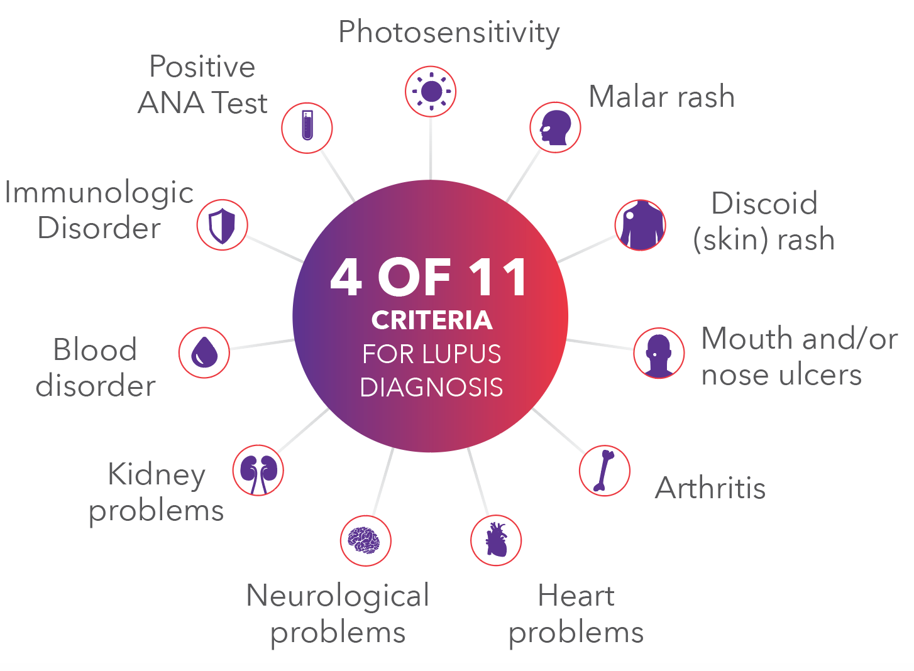
The eleven criteria for lupus diagnosis
11 clinical criteria for lupus diagnosis
  At least four of the eleven criteria for lupus are typically present for lupus diagnosis:
Notes:
Here you can see the eleven clinical criteria that doctor’s use for lupus diagnosis:
Photosensitivity – unusually strong reaction to sun light, causing a rash or flare. Because many people with lupus are sensitive to sunlight (called photosensitivity), skin rashes often first develop or worsen after being out in the sun.
Malar rash – about 30% of people with lupus experience a characteristic red “malar” rash or color change that may appear across the cheeks and bridge of the nose in the shape of a butterfly.
Discoid (skin) rash – raised red patches
Mouth and/or nose ulcers – usually painless
Nonerosive arthritis – inflammation in two or more joints
Cardio-pulmonary involvement – inflammation of the heart lining and/or lungs
Neurologic disorder – seizures and/or psychosis
Kidney disorder – increased protein or clumps of red blood cells in urine
Blood disorder – damaged red blood cells, low white cells, or low platelet count
Immunologic disorder – when your immune system attacks healthy cells
Positive antinuclear antibodies (ANA) test – positive blood test not induced by drugs
Reference:
1. www.lupusresearch.org

Slide 10

Who gets lupus?
Anyone can get it
Approximately 161,000 to 322,000 U.S. adults are living with lupus
Some people are at greater risk:
  Women between the ages
  of 15-44
  Certain races and ethnicities,
  particularly those of
  African American, Hispanic,
  Asian, or Native American descent
  People with a family history
  of lupus or autoimmune
  disease
Notes:
Anyone can get lupus. Systemic lupus erythematosus affects from 161,000 to 322,000 U.S. adults.
Some people have a greater risk of getting lupus:
Women make up nine out of ten adults with the disease.
Lupus most commonly first strikes between the ages of 15 & 44.
Women of African American, Hispanic, Asian, or Native American origin also are more prone to lupus than Caucasians.
African American women are three times more likely than Caucasian women to have lupus.
A family history is also a risk factor for lupus.
References:
www.lupusresearch.org
www.arthritis.org
Seminars in Arthritis and Rheumatism. Understanding the Epidemiology and Progression of Systemic Lupus Erythematosus. 2010.
National Institutes of Health (https://report.nih.gov/nihfactsheets/ViewFactSheet.aspx?csid=47)
Epidemiology. Estimates of the prevalence of arthritis and other rheumatic conditions in the United States: Part I. 2007.

Slide 11

What to do if you suspect lupus
Write down your symptoms and talk to your health care provider
Ask your doctor to refer you to a rheumatologist
To learn more, go to the Lupus Research Alliance website: lupusresearch.org
*Consult your doctor before changing your diet or exercise routine.
Notes:
If you suspect that you or a loved one has lupus, the first step is to write down your symptoms and go to the doctor. We will be handing out some information at the end of this session with tips on where you can go to learn more about lupus.
You can also talk to your doctor and with their guidance, be referred to a rheumatologist for an exam. Lupus is generally treated by a team of physicians led by a rheumatologist. A rheumatologist specializes in arthritis and other inflammatory diseases.
Reference:
1. www.lupusresearch.org

Slide 12

If you have been diagnosed with lupus
People’s experiences living with
lupus are varied
  Lupus can have a serious impact on quality of life
Lupus patients have higher risk for many other health problems, including:
  Cardiovascular disease
  Diabetes
  Kidney disease
While there is no known cure for lupus, effective methods for managing symptoms are available
  Early diagnosis can help
  Research is ongoing
Notes:
While no two cases of lupus are alike, lupus can have a significant impact on daily life.
Beyond the general symptoms of fatigue and inflammation, having lupus can put you at a greater risk for other serious health problems, such as cardiovascular disease, diabetes, and kidney disease.
While no cure for lupus currently exists, there are treatments that can reduce symptoms. The Lupus Research Alliance funds research that is aimed at learning more about lupus, creating more effective treatments, and hopefully one day identifying a cure.
References:
Rheum Dic Clin North America. Health-related quality of life and employment among persons with systemic lupus erythematosus. 2010.

Slide 13

Finding a cure for lupus
The Lupus Research Alliance is transforming the lives of people affected by lupus through innovative research programs, with funds donated by the public
The end goal: to speed new treatments, prevention, and a cure to lupus patients
go to support research programs
fostering scientific breakthroughs
in support of
novel research
Notes:
Lupus is a complex autoimmune disease that is difficult to diagnose, treat, and defeat, with only one treatment approved specifically for lupus in nearly 60 years. The Lupus Research Alliance is committed to funding promising investigations that help advance the understanding of lupus, develop an array of more effective treatments with fewer and less severe side effects, and ultimately find a cure.
The Alliance’s comprehensive grant program attracts new scientific talent to the field and provides opportunities for researchers to pursue the most novel ideas as well as to advance proven approaches that improve treatment.
Because the Board of Directors funds all Lupus Research Alliance administrative and fundraising costs, 100% of all other donations go directly to support research programs.
Reference:
1. www.lupusresearch.org

Slide 14





How can you get involved?
Learn more about the Lupus Research Alliance on our website, follow us on social media, and participate online on our Community Forum @community.lupusresearch.org
Talk to your friends and family about lupus awareness
If you have lupus, talk to your doctor about participating in a clinical trial
You can be part of the solution for better treatments!
@lupusresearchalliance
@LupusResearch
Lupus Research Alliance
@LupusResearchAlliance
Notes:
Now that you’ve learned more about lupus and lupus research, we want to make sure you’re aware of ways you can get involved.
The Lupus Research Alliance has resources available online for those who want to get involved in fundraising efforts and events.
A major goal of the Lupus Research Alliance is to raise awareness; you can help in this effort by talking to your friends and family about what lupus is and how lupus impacts those who have it.
If you have lupus, talk to your doctor about participating in a clinical trial. The Lupus Research Alliance is actively involved in recruiting for and facilitating clinical trials across the U.S..

Slide 15
Learn about clinical trials
What is the purpose of a clinical trial?
  Clinical trials help to answer the question, “will this drug help people and is it safe?”
Clinical trial volunteers work with researchers to find safer, more effective ways to diagnose, prevent, and ultimately cure lupus
In 2016, the Lupus Research Alliance launched the Lupus Clinical Investigators Network (LuCIN)
For more information or to find a trial near you, go to: lupusresearch.org/trials
Emotionally, taking part in a trial is very empowering. I feel like I have a sense of responsibility to the lupus community to do everything I can to help everyone dealing with this disease. – Kaamilah
Notes:
You may be wondering, “what is a clinical trial?”
Clinical trials help to answer the question, “Will this drug help people and is it safe?”
In clinical trials, people volunteer to test new treatments, interventions or tests, so researchers can determine what does and doesn’t work. Clinical trials also help researchers and doctors decide if the benefits outweigh possible side effects.
Lupus research has been greatly advanced by the caring people who participate in clinical trials. In these studies, scientists and participants work together to find safer, more effective ways to diagnose, prevent, and ultimately cure lupus.
All drugs must be tested in clinical trials to be approved by the U.S. Food and Drug Administration as treatments for lupus. And volunteers that represent every potential patient group are critically important.
In 2016, the Lupus Research Alliance launched the Lupus Clinical Investigators Network (also known as LuCIN). LuCIN is a Lupus clinical trials network, made up of almost 60 of the most prestigious academic research medical centers throughout North America. Founded and sponsored by the Lupus Research Alliance, LuCIN brings together experts to evaluate the safety and effectiveness of potential treatments for lupus. For more information on LuCIN or participating in a clinical trial, visit lupusresearch.org/trials.

Slide 16
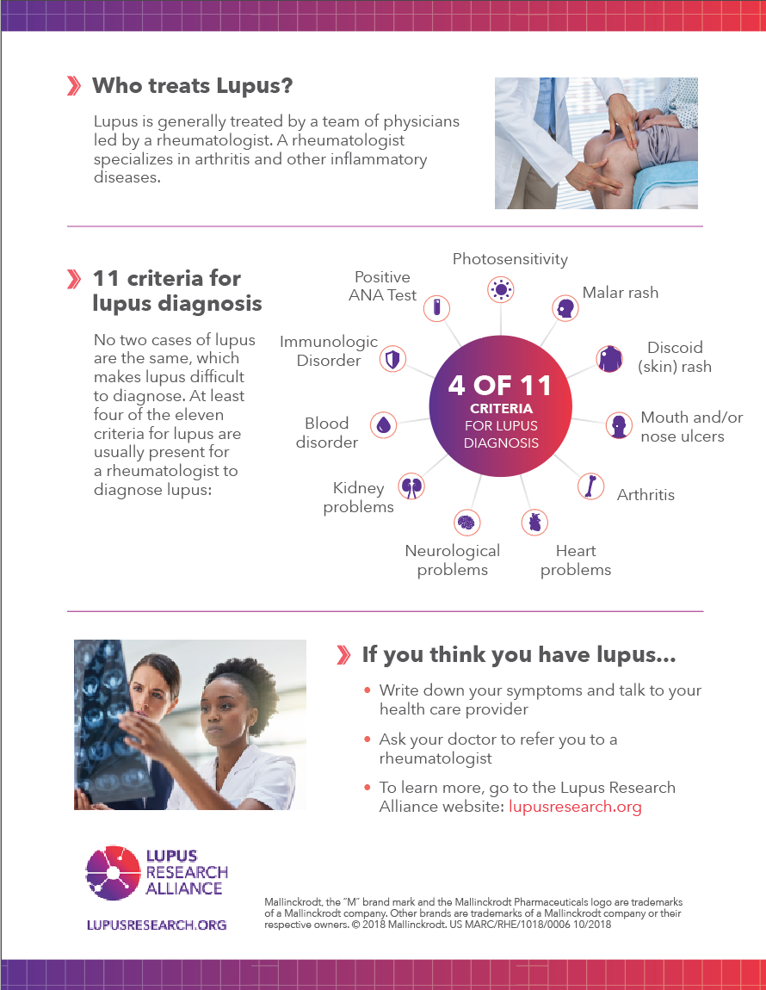
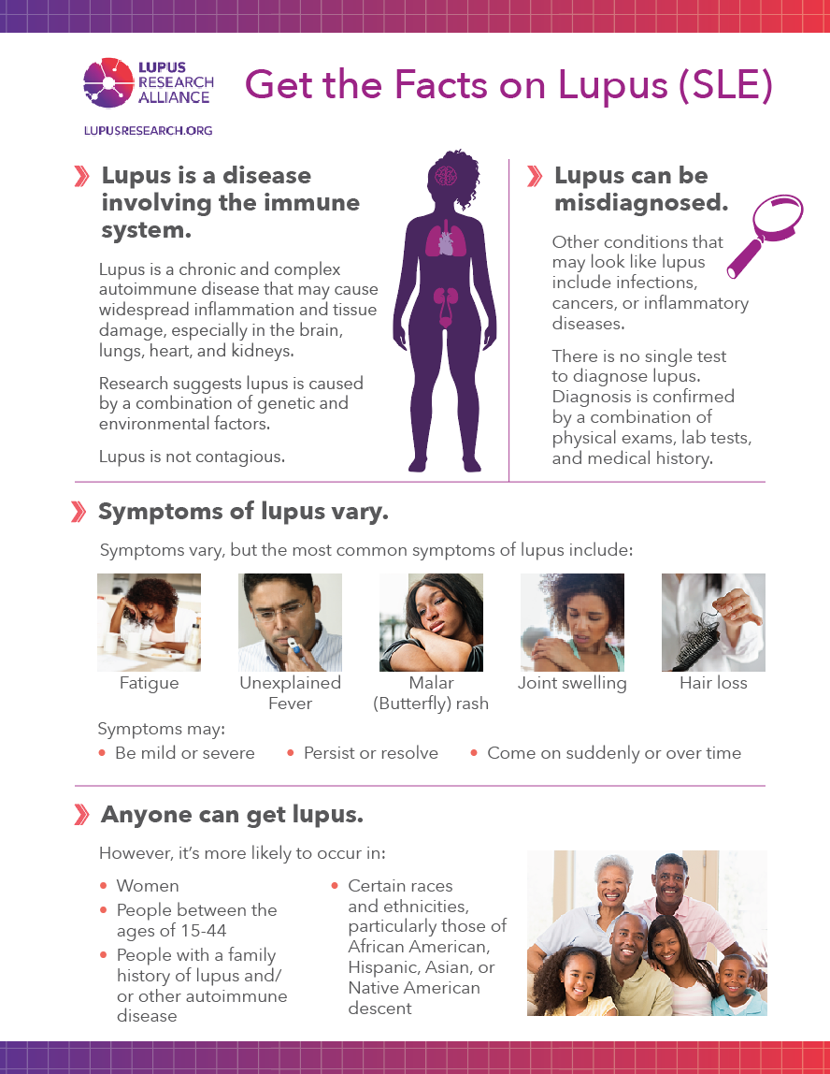
To learn more
Lupus Research Alliance: lupusresearch.org
Lupus Clinical Trials: lupusresearch.org/trials
Get the Facts on Lupus Handout

Slide 17
QUESTIONS?

Slide 18

Materials made possible by:
Mallinckrodt, the “M” brand mark and the Mallinckrodt Pharmaceuticals logo are trademarks of a Mallinckrodt company.
© 2018 Mallinckrodt. US MARC/RHE/1018/0005 10/2018

Slide 19
THANK YOU

